Slide 1


Beyond Marketing: Customer Relationship Management (CRM)
Thursday 11:30am – 12:45pm
One State: Together in the Arts
Illinois Arts Alliance Foundation & Illinois Arts Council

Slide 2
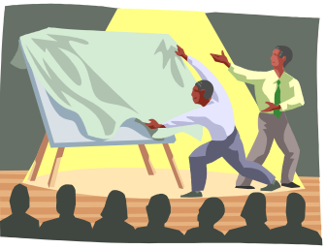
Session Presenters
Tim Sullivan
Managing Consultant, ASPIRE - Total Customer Development Consulting and Delivery Firm.
CRM and Interactive Marketing Pioneer and Innovator with 15 Years of Experience.
Board Member, Customer Relationship Management Association – CRMA-Chicago.
Jim Hirsch
Vice President and Executive Director, Chicago Theatre and Chicago Association for the Performing Arts – CAPA.

Slide 3

Session Goals & Agenda
Understand CRM, Components & Strategies
Understand CRM Best Practices, Value & ROI
Understand How Arts Groups Can Best Use CRM
Arts Group CRM Success: A Customer and Competitive Necessity (25 min)
Permission-Based E-Mail Marketing: The Future of Audience Development (25 min)
Q&A (25 min)

Slide 4

Arts Group CRM Success:
A Customer and Competitive Necessity
ASPIRE
Total Customer Development tm

Slide 5

Why CRM is a Customer and Competitive Necessity
It typically costs 5-10 times as much to acquire a new customer as it does to retain an existing one.
“Some companies can boost profits by almost 100% by retaining just 5% more of their customers.” Harvard Business Review (Reicheld & Sasser)
A recent McKinsey study showed that the average new customer spends $24.50 at a given web site in the first 3 months as a shopper. The average repeat customer spends $52.50 every 3 months.
Most companies lose 50% of their customers in 5 years (Harvard University)
On average only 15% of a site’s customers consider themselves loyal to it. The loyalty rating among people who had experienced a problem was only 6%. Customers who had not experienced problems indicated a customer loyalty rating of 19%. The loyalty rating among customers who had experienced problems but were satisfied with the way they were handled: 21%. (Digital Idea)
70% of repeat purchases are made out of indifference to the seller, NOT loyalty. (eLoyalty)
The web customer is ‘only 1 click away from your competition’.

Slide 6

What is Customer Relationship Management (CRM)?
Customer Relationship Management (CRM) is: the integration of sales, marketing, service and support strategy, process, people and technology to maximize customer acquisition, value, relationships, retention and loyalty.
  A Redesigning of your Business from the Outside In.
  Customers, Data and Database at the Center of your Organization (Customer-centricity).
  A organization-wide single customer view.
  A Foundation for “1to1 Marketing: Treating Different Customers Differently” (Single Ticket Buyer vs. Subscriber)
  A Means to Your Total Customer Development Ends.

Slide 7

Total Customer Development™ Hierarchy
Customer Actualization Management tm
Customer Evangelism Management tm
Customer Lifecycle Management
Customer Experience Management
Cause Marketing Management
Customer Quality Management tm
Customer Innovation Management tm
Customer Relationship Management
Interactive Marketing Management

Slide 8

CRM Strategies
Customer Acquisition
Gain the greatest number of new “Best” customers as early in their “lifespan” as possible.
Customer Retention
Retain and expand your business and relationships with your customers through up-selling, cross-selling and servicing.
Customer Loyalty
Offer programs to ensure that your customers happily buy what you offer only from you.
Customer Evangelism
Enable loyal customers to become a volunteer sales force.
Cost Reduction
Reduce costs related to marketing, sales, customer service and support.
Improve Productivity
Enhance your e-business strategies.

Slide 9

The “Customer”
Customer Segments
  Suspects, Visitors, Prospects, Subscribers, Patrons, Members, Ticket Buyers, Users, Consumers, VIPs, Volunteers, Annual / Major Donors, Advisors, Advocates, Legislators, Strategic Partners, Sponsors …
  What data do really you have on your customers’ Problems, Pains, Fears, Needs, Wants, Likes, Goals, Influences, Relationships, Affiliations, Alliances, Experiences, Aspirations, Options, Expectations, Questions, Knowledge, Skills, Activities, Attention, Communications, Interactions, Emotions, Memories, Satisfaction, Perceptions, Beliefs, Admirations, Attitudes, Opinions, Values, Learning, Ideas, Motivations, Objections, Priorities, Choices, Behaviors, Personality, Self-Concepts, Trust, Loyalty, Attention, Recognition, Time, Energy, Risks, Investments, Rewards, ROI, Lifestyle, Lifecycle Stage, Social Class, Culture, Sub-culture, Age, Family, Education, Hobbies, Interests…?

Slide 10

CRM People
“Customers”
  Suspects, Visitors, Prospects, Subscribers, Patrons, Members, Ticket Buyers, Users, Consumers, VIPs, Volunteers, Annual / Major Donors, Advisors, Advocates, Legislators, Strategic Partners, Sponsors …
Users
  Management, Employees, Visitors
Suppliers
  Services - Consultants
    CRM / Customer Development Experts
  Products - Technology
    Software, Hardware, Connectivity

Slide 11

CRM Processes / Mapping
Re-examine all of your customer management business processes.
Re-/define where CRM provides the greatest value to your “best” customers and your organization.
  Don’t “repave the cow paths”
Incrementally implement CRM to improve top targeted processes.
  Ex. Subscription Renewal processes

Slide 12
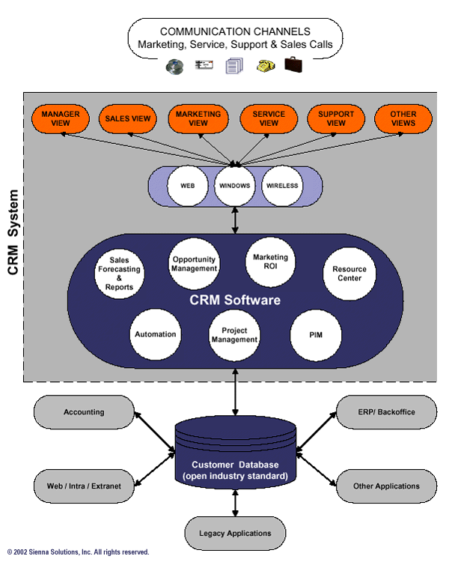
Customer Relationship Management CRM Model

Slide 13
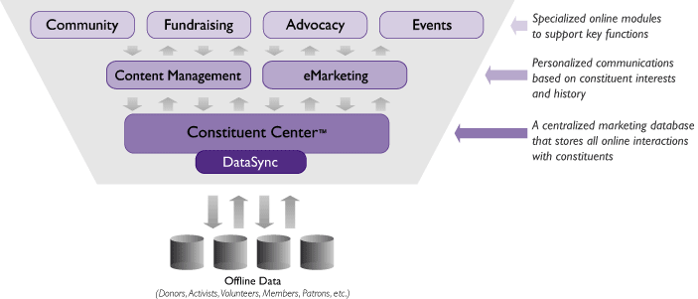
Non-Profit / Arts Organization eCRM Model

Slide 14

Non-Profit / Arts
Organization eCRM Systems
E-Marketing Management
E-mail Marketing: Alerts, E-Newsletter Management
E-Surveying: Progressive Profiling Management
Viral Marketing: Tell-a-Friend Management
Web Design: Registration, Subscription, VIP Management
Online Community / E-Suggestion Box / Blog Management
E-Commerce: Memberships, Event Registration Management
Affiliate Management: Sponsorship Management (Boston Symphony)
Reporting / Analysis: Profiles, Behaviors…

Slide 15

CRM Technology / Infrastructure
Operating Systems
  Windows 9x…, Mac, Unix, Linux, Browser
Point Solutions vs. Suite
  Homegrown, Packaged or Hosted
  Toolkit, Integrated Best of Breed or All-in-One
Application/Data Integration
  Accounting, Financial, Other Systems
IT / Consultant
  Support, Budget, Time

Slide 16

Why Arts Organizations
Must Adopt CRM
Arts groups today are struggling to do more with less.
Rising competition for entertainment/donor dollars, especially as supporters reduce the number of causes they support.
The need for new programs and services continues to grow.
Budgets have tightened in the wake of declining endowments, reduced government, corporate and foundation funding.
Organizations are finding it tougher to sustain sales, fundraising and other forms of constituent support as traditional marketing models are not working as well.
Must add and integrate additional customer information and communication channels to respond to demand.
The “New Consumer” / “Buyer-Centric” market demands it.

Slide 17

The “New Consumer” /
“Buyer-Centric” Market
Relevancy
I am not overloaded by irrelevant data.
Experiences
I seek “Memorable and Remarkable Experiences” over Products.
Attention
I am unwilling to waste attention. You must earn It.
Value
I expect to receive 2-3x value in return for investing my attention.
Desire For Knowledge and Individuality
I desire information that is valuable to me because it enables me to decide what to do, and how best to do it.
Decoded Complexity
I will turn to reliable sources of “evaluated” information and may find it convenient to complete my purchase at the same time, and at the same point.

Slide 18
The “New Consumer” /
“Buyer-Centric” Market
Not Deliberately Misled or Confused
Your uncoordinated marketing communications result in a lack of congruency or no “single version of the truth” to me.
Organizational Memory
I expect all employees that I interact with to “know” me.
Respects Privacy
My data is not shared with anyone and is only used to improve your value and service my needs.
Problems and Needs
I expect you to solve my current and future problems and needs quickly, professionally and efficiently.
Can Quickly Find Information Pertinent to Current Interests
Ideal: Let me define what information I am interested in, and “an agent” would go and find it for me, and report back later in a form, at a time, on a device, and over a medium appropriate to me.

Slide 19
CRM Goals, Benefits and Value
⇑ Increased Hard / Soft Results ($,%,#)
⇑ Internal: Revenue, Margins, Profitability, Results, ROI, ROA, Conversion Rates, Knowledge, Strategy, Efficiency, Effectiveness, Creativity, Products, Innovation, Morale, Customer Focus…
⇑ External: Customer Acquisition, Up-selling, Cross-selling, Personalization, Interaction, Feedback, Service, Satisfaction, Loyalty, Evangelism, Relationships, Value, Understanding…
⇓ Decreased Hard / Soft Results ($,%,#)
⇓ Internal: Costs, Time, Errors, Employee Defection, Frustration, Fear, Uncertainty, Doubt…
⇓ External: Customer Issues, Complaints, Attrition, Churn Dissatisfaction…

Slide 20

CRM Metrics
Response Rates
Well-executed event-driven marketing campaigns typically deliver response rates of the order of 25% - 50%.
Increased Sales
A well-used CRM system typically yields a direct sales revenue increase of 10%-20%.
Customer Retention
Improvement of Average Observed Customer benefit 10%-18% for Customers That Formally Measured.
ROI Justification
A 10% improvement in customer retention and increased revenues and a 14% increase in customer satisfaction, though small, can provide all the justification any company needs to implement a CRM system. (Aberdeen Group 2003)

Slide 21

CRM Project Planning
CRM Innovation Management tm
1. Investigate Needs
  Define Successes
  Identify Gaps
Define Organizational / Customer Requirements
  Use Cases, Internal/External Processes
  Features, Functions and Technical
2. Create Ideas
  Business Case, CRM Plan
    Cost Justification, ROI
4. Evaluate Solutions
  Select based on Best Fit to Requirements

Slide 22
CRM Project Management
4. Activate Plans
Prioritize - Scope
Design - Review
Install - Configure
Pilot - Adjust
Launch - Measure
Support - Grow

Slide 23

CRM Best Practices /
Critical Success Factors
Customer-Centric Design
  Leverage Your Marketing Plan, Strategies and Segments.
  Based on Customer Value, Requirements and Related Processes.
Project Plan and Methodology
  Establish Prioritized and Firm Requirements, Scope, Team.
  Nuggets: Demonstrate credibility-building quick results first.
Top Management Sponsorship
  Secure On-going Figurehead, Vision, Communication, Commitment.
User Buy-in and Use
  Train, Fun, Communication, Enthusiasm, Motivation, Workshops, Support, Recognition, Rewards, Punishment?
Track Key Metrics and Grow
  Increased / Decreased Sales, Costs, Profitability, Satisfaction $, %, #…
How well has CRM solved your current business problems and delivered results?

Slide 24

Arts Organizations
CRM Case Studies
The Royal Shakespeare Company: Needed first-rate data analysis of our customer information and feedback to inform programming, pricing and virtually every other aspect of their business. Wanted to create an organization that was thoroughly customer informed. “We can now confidently predict that the use of CRM is going to help us to achieve most of our business objectives. It shows that we can all benefit: we will be more efficient and - because we will be better informed - we can be bolder in our decision making. And it works at every level from artistic planning decisions down to seating plans."
Carnegie Museums of Pittsburgh: Increased its email house file more than 50 % in just 8 months. Now sends quarterly newsletters to members. The average online gift is 16 % higher than offline gifts. Attendance is up for events that are marketed & managed online.
HoustonPBS: Raised more than $123,000 online via pledge drives in 14 months. Has completed 33% of event registrations online. Used online communications in the wake of eliminating roughly $150,000 annually in paper-based communications. Just launched a “members only” area, offering a wide array of services, which will help to grow loyalty.

Slide 25
Arts Group
CRM Issues & Examples
How can Arts organizations:
· Employ basic CRM strategies to get more out of under-targeted / marketed contacts that languish on mailing lists, or are used inconsistently at best?
Intercept/E-/Surveys to discover and capture contacts (demographics, past interactions, interests, needs, behaviors, problems, aspirations…), desired format and frequency of communications to segment and increase marketing relevancy and value.
Incentives, Opt-in Registrations, Subscriptions, E-Newsletters, Auto-Responder “Courses”…

Slide 26
Arts Group
CRM Issues & Examples
How can Arts organizations:
· Use an upgraded CRM program to increase ROI on the best customers/ heavier users?
You MUST understand what your Customers THINK and how they behave through continual question-asking and capture it in your enhanced CRM database to drive loyalty & evangelism marketing communications and campaigns.
Improved Customer E-/Surveying, Profiling, Segmenting, Targeting, Communication, Interaction, Conversion, Up-Sell/Cross-Sell, Loyalty, Viral E-Mail, VIP Program, Evangelism.

Slide 27
Arts Group
CRM Issues & Examples
How can Arts organizations:
· Begin to think about solving problems and use a CRM system for their users i.e. providing concierge type services to incent attendance and make things easier?
Leverage The Experience Economy / Customer Experience Management (CEM): Need to transform your value delivery to constantly creating memorable and remarkable customer experiences vs. “selling” art, tickets, admissions.
Remove barriers to Non-attendance by E-/Surveying, recording in your CRM database, partnering/extending your services offering, and target Direct Mail/E-Mail/Web marketing.
Save customers time. Think/Act like Amazon.com

Slide 28
Arts Group
CRM Issues & Examples
How can Arts organizations:
· Use a CRM program to quickly respond to changing market realities?
Down economic conditions, war and the growing uncertainties require maximizing “mind-share” with your constituents, getting them involved, and increasing and sustaining your relevance.
Create a community. Use marketing metaphors.
Leverage E-/Surveys, E-Marketing/E-Mail, Web Site, Communities, Blogs, Testimonials, Customer Concern Management database, FAQs…

Slide 29
WHAT CRM Tactics Can We Do Quickly, Easily, Inexpensively & Get Results?
Define Your CRM Process, Requirements and Select a System that:
Best Meets Your Current & Future Requirements.
Delivers that Greatest Value to Your Customers - Ask Them
Implement and Leverage the CRM System:
Based on your Marketing/Project Plan & Business Case.
Define, Target, Personalize, Test, Manage, Measure, Tune integrated Offline/Online Marketing Campaigns.
Develop & Segment Your Contact List / Database:
Top 20%, Most Valuable / Best Potential Customers, Network Hubs/Media, Influentials by Interests, Needs…
Partner on “Fit” Lists, Marketing Campaigns etc.
Make contacts aware of your Privacy & Data Protection Policy as an initial E-Mail message & Campaign.

Slide 30
Arts Group
CRM Summary
· Arts Groups should focus on CRM:
Ease of Use, Intuitive interfaces, Broad but not deep Functionality, Being Rapidly Deployable and Having a Lower Cost to Buy and Maintain to:
  Increase Customer Acquisition, Retention, Loyalty and Evangelism
  Increase Efficiency and Effectiveness - Productivity
  Increase Revenue and Decrease Time and Costs
Segment and consider the value and appropriateness of communication channels and timing, responsiveness and honesty in customer inquiries for information.
Permission-based Marketing, Permission E-Letters, E-/Surveys, E-Mail: E-Newsletters, E-Postcards, Viral Marketing/Word of Mouth, Online Communities, Registration, Memberships, E-/Contests, E-Cause Campaigns / Events…

Slide 31
Arts Group
CRM 3 Final Thoughts
“As you better understand your customer base, you will be able to develop ever better business rules and processes, which will fuel personalisation engines, drive customer contact strategies and maximise marketing effectiveness.”
“Continuing to deliver a consistently improving experience to consumers across multiple channels will determine a company’s ability to retain customers over time, thereby enhancing their lifetime value to the company.”
eCRM / E-Mail marketing on-the-job training is playing with fire. “It is important to work with a team experienced in delivering successful eCRM projects and integrating them with existing business processes. eCRM / E-Marketing, more than any other discipline, represents the ultimate fusion of marketing and IT skills and knowledge.“
1 Year Benchmark: How much have you improved your key customer development metrics by May 17, 2004?
CRM meets eCRM: An Executive Briefing, February 2001, Ashley Friedlein

Slide 32
Arts Group CRM Success:
A Customer and Competitive Necessity
ASPIRE
Total Customer Development tm

Slide 33

The eCAPA Experience:
November 2000 - Present
The Joyce Foundation

Slide 34

Permission Based
Marketing
A program based on consumers granting a marketer permission to communicate with them.

Slide 35
Call to Action:
Sign up for eCAPA and receive special offers for Chicago Theatre events

Slide 36
Basics of eCAPA Membership:
Anyone with an email address can join at no cost
Members have ability to purchase tickets to most Chicago Theatre shows before general public
Members will occasionally receive email only offers for discounted or free tickets
Members will never have their name/email address sold or given to another organization.
Members can opt out at any time

Slide 37
Our Philosophy:
Only send messages that have value to the consumer.

Slide 38
eCAPA: The First Year
Most addresses collected via lobby intercepts
5-10% of audiences typically responded (150-350 email addresses for a sold out show)
4,000 names by Spring 2001

Slide 39
eCAPA: The First Year
Almost all email addresses entered manually by Chicago Theatre staff
Database hosted by list-serv company
  Emails sent in text format
  No segmentation
  No information on click-thrus, bounces or opt-outs
  Effectiveness measured entirely by number of purchases made with ticket code

Slide 40
eCAPA: The Second Year
August, 2001:
CAPA receives funding from the Joyce Foundation to further develop program with an emphasis on attracting African-American and Hispanic audiences, and with a goal toward sharing “best practices” with other organizations

Slide 41
eCAPA: The Second Year
November 2001: CAPA conducts online survey sent to 7,878 subscribers (326 respond)

Slide 42
Survey Respondent Demographics
73% female
70% have no children in household
Ethnicity
  64% Caucasian
  26% African American
  6% Hispanic
  2% Asian

Slide 43

Survey Respondent Demographics

Slide 44
Survey Respondent Email Usage
Business
  Several times a day (66%)
  Once a day (8%)
  N/A (21%)
  2-3 times a week (3%)
  Once a week (2%)
Personal
  Several times a day (52%)
  Once a Day (24%)
  2-3 times a week (13%)
  Less than once a week (5%)
  N/A (4%)

Slide 45

Why do you delete unread email?
Not interested in subject line (67%)
Don’t know who from (42%)
Looked like spam (33%)

Slide 46
Where did you sign up for eCAPA?
48% at Chicago Theatre event
35% via the CAPA website
12% via ticketmaster.com
(In past year higher percentages coming from Ticketmaster and CAPA websites)

Slide 47
Responsiveness
32% have purchased tickets after receiving e-mail
  25% of men
  18% of women
20% forward eCAPA e-mails to others

Slide 48
Customer Satisfaction
  88% very or somewhat satisfied
  6% somewhat unsatisfied
  1% mostly unsatisfied
  5% n/a

Slide 49
How Often Do You Want Emails?
Once a week (30%)
As often as new info is available (26%)
Twice a month (21%)
Once a month (11%)

Slide 50
What Do Audiences Want?
Discounts (99%)
Ticket presale (97%)
Getting regular info via e-mail (94%)
Ability to link to further info on artist or event (92%)
Special offers from sponsors (88%)

Slide 51
eCAPA: Spring 2002
Database is about 10,000 strong
Ticket sales positively affected:
  December 2001: 450 tickets to Concert for a Landmine Free World
  May 2002: 818 tickets for over $40,000 to Ellen DeGeneres
  July 2002: CAPA raffled 50 tickets to “Road to Perdition” – received 1700 requests in 24 hours

Slide 52
May 2002: Getting Fancier
Began using PatronMail, an internet-based Application Service Provider
  Sending HTML emails, as well as text
  Track open rates, click-thrus, opt-outs, referrals and bounces
  Allows users to indicate preferences - segmentation

Slide 53
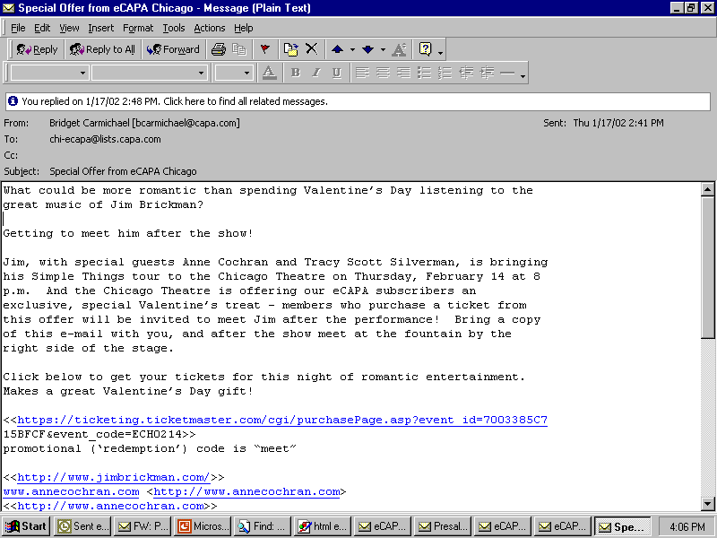
Text E-Mail

Slide 54
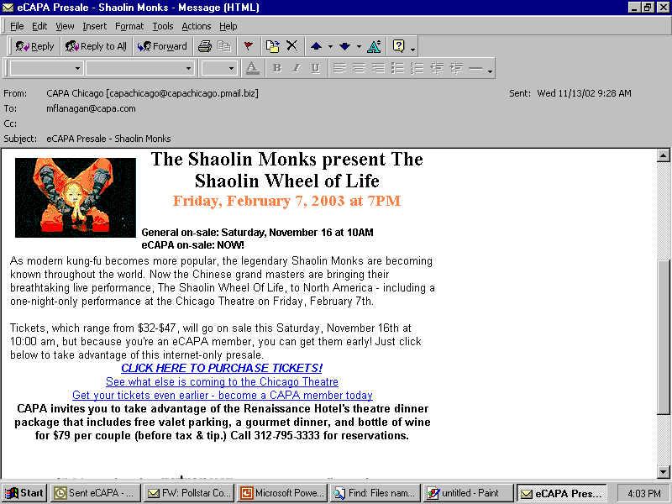
HTML E-Mail

Slide 55
Why Segmentation?
“I signed up because I wanted to get tickets for Prince – I don’t care about Donny Osmond!”

Slide 56
Segmentation = Better Results
Campaigns sent to segmented lists have 49% open rate, compared to 27% in non-segmented lists (CAPA experience)
From May – October 2002, only 21 people on segmented lists (less than 1%) opted out – 555 (almost 4%) opt-out rate on non-segmented lists
Relevance = Retention

Slide 57
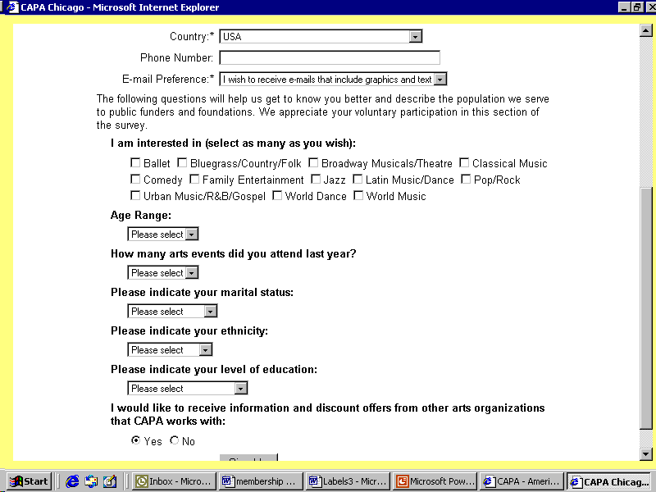
E-Survey / Progressive Profiling

Slide 58
August 2002:
Time for a Check Up!
Second survey went to 10,464 people – over 1,400 people responded
Welcomed suggestions and comments on programming, eCAPA and theatre experience
Comments overwhelmingly positive: consensus was “give us more!”

Slide 59
eCAPA User Comments
“I enjoy the email updates. I don’t need any more mail at home to sort through and recycle. This system works great!”
“I like the frequent but not intrusive nature of your marketing. I like it that I’m informed about upcoming performances.”
“I enjoy getting the e-mail reminders, without which I would miss too many opportunities to see favorite performers.”

Slide 60
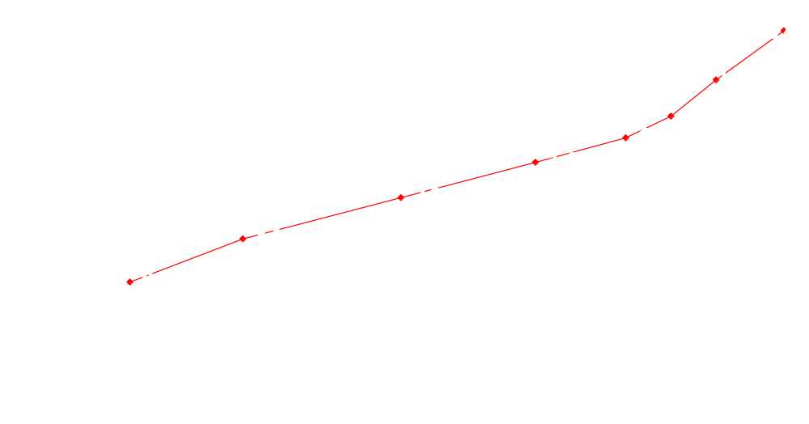
eCAPA List Growth

Slide 61
Click Right In!
Getting your eMarketing Campaign Started

Slide 62
Develop Guidelines
What needs/wants will your email program fulfill?
How often will you communicate with your subscribers?

Slide 63
Check Out Your Options
Research internal software and external hosting options for storing your database
We recommend making sure you can track results and send HTML emails
HTML messages are 340% more effective, but some users still can’t receive them. Most ASPs have “sniffer” technology .

Slide 64
Sign up Patrons
Encourage direct mail patrons to move to email
Make email program part of overall marketing scheme – include mentions in all materials
Place sign-up prominently on website
Make sure box office staff offer information about email program and encourage sign-up.

Slide 65
Methods of Building a List
Adding w/o permission – NO!
Opt-out: patrons must uncheck box
Opt-In: Customers indicate willingness to receive info
Double opt-in: customer must reply to email to be added

Slide 66
Make Sure You Give Patrons What They Want
Use on-line surveys to understand patrons needs
Talk to patrons at venue, on phone, via email
Take their suggestions seriously – they’re the boss!

Slide 67
Internet Marketing is Viral
Encourage and incent forwarding – a relevant email can reach more people through forwarding
CAPA recently entered patrons who told friends about eCAPA into a drawing for a Cirque du Soleil VIP package – almost 1000 people passed the email on to their friends
April 2003’s “The Wiggles” presale went viral and resulted in over 2000 tickets sold and 100 new CAPA memberships

Slide 68
Use Good Subject Lines
You have 4-5 words to capture attention
Be consistent so they’ll recognize you
Avoid “free”, “!!!” all caps and other frequent “spam” terms – you might get blocked
“From” line should clearly indicate sender (in our case, CAPA Chicago)

Slide 69
The Process
Develop offer
Create email
Test
Send
Evaluate results

Slide 70
Keeping Your List
Work hard to keep information relevant
Customer service is key – designate someone to respond quickly to problems or complaints
Never, never, never violate permission!

Slide 71
Small Scale eMarketing
You can use Outlook/Lotus, etc
Remember to use bcc field!
Ask your friends to sign up
Mobilize members to recruit & share email addresses
Ask permission!
Make it interesting & compelling

Slide 72
The Future is Now!
Streaming video
Audio clips
Currently just over half of email users can interact w/streaming media, but that will go up!

Slide 73
Email marketing benefits:
Inexpensive
Instant results
Encourages interaction
Drives Ticket Sales Revenue
Drives Membership Revenue
Decreases Marketing Costs

Slide 74
Conclusion:
Permission based email marketing is an essential part of a well-rounded marketing plan
Be sure to use email properly – get permission and be relevant!

Slide 75
Permission Based Email Marketing
The Future of Audience Development
The Joyce Foundation

Slide 76
CRM Resources
Websites, E-Zines, White Papers
  CRMCommunity.com
  CRMGuru.com
  DestinationCRM.com (CRM Magazine)
  SearchCRM.com
Publications & Articles
  CRM Magazine www.DestinationCRM.com
  1 to 1 Magazine www.1to1.com
  Customer Inter@ction Solutions Magazine www.cismag.com
Books
  CRM Automation, Barton J. Goldenburg
  The CRM Handbook, Jill Dyche
  The Ultimate CRM Handbook: Strategies and Concepts for Building Enduring Customer Loyalty and Profitability, John G. Freeland
  CRM at the Speed of Light: Capturing and Keeping Customers in Internet Real Time, Paul Greenberg
Associations, Groups, Meetings & Conferences
  Customer Relationship Management Association - CRMA-Chicago www.crma-chicago.org
  DCI CRM Conferences www.dci.com
  Association for the Advancement of Relationship Marketing - AARM www.aarm.org
Consultants
  ASPIRE - Arts Group CRM QuickStart* www.aspireto.com/AGCRMQS.htm
  Accenture www.accenture.com
  Cambridge Solutions www.cambridge-solutions.com

Slide 77
E-Marketing Resources
Websites, E-Zines, White Papers
  E-MailSherpa www.marketingsherpa.com
  Full Sterne Ahead, Jim Sterne's E-Newsletter www.targeting.com
  ClickZ www.clickz.com
Publications & Articles
  Direct Magazine www.DirectMag.com
  1 to 1 Magazine www.1to1.com
  Direct Marketing News wwwDMnews.com
Books
  Permission Marketing, Seth Godin, Simon & Schuster
  Unleashing the Idea Virus, Seth Godin, Hyperion
  Don't Make Me Think, Steve Krug, New Riders
  Email Marketing, Jim Sterne and Anthony Priore, Wiley
Associations, Groups, Meetings & Conferences
  Chicago Interactive Marketing Association (CIMA) www.ChicagoIMA.org
  Direct Marketing Association (DMA) www.DMA.com
  American Marketing Association (AMA) www.MarketingPower.com
Consultants
  ASPIRE - Arts Group E-Marketing QuickStart* www.aspireto.com/AGEMQS.htm
  Carat Interactive www.carat-interactive.com
  TMA E-Marketing www.tmaemarketing.com

Slide 78
Questions & Answers
Strategy?
Process?
People?
Technology?
Planning?
Implementation?
Results?
Other?

Slide 79
Follow-Up Questions?
Tim Sullivan
Managing Consultant, ASPIRE - Total Customer Development Consulting & Delivery (www.aspireto.com)
CRM and Interactive Marketing Pioneer and Innovator with 15 Years of Experience. **(tim.p.sullivan@aspireto.com)
Board Member, Customer Relationship Management Association – CRMA-Chicago. (www.CRMA-Chicago.org) **(773-252-4140)
Jim Hirsch
Vice President and Executive Director, Chicago Theatre and Chicago Association for the Performing Arts – CAPA.
Other Relevant Credentials?
(www.CAPA.com) (JHirsch@CAPA.com) (312-263-1138)

Slide 80

Thank You
We Welcome Your Feedback…

